Slide 1
Project Molecule
MAY1739
Advisor: Arun Somani
Ryan Wade, Nathan Volkert, Daniel Griffen, Alex Berns

Slide 2
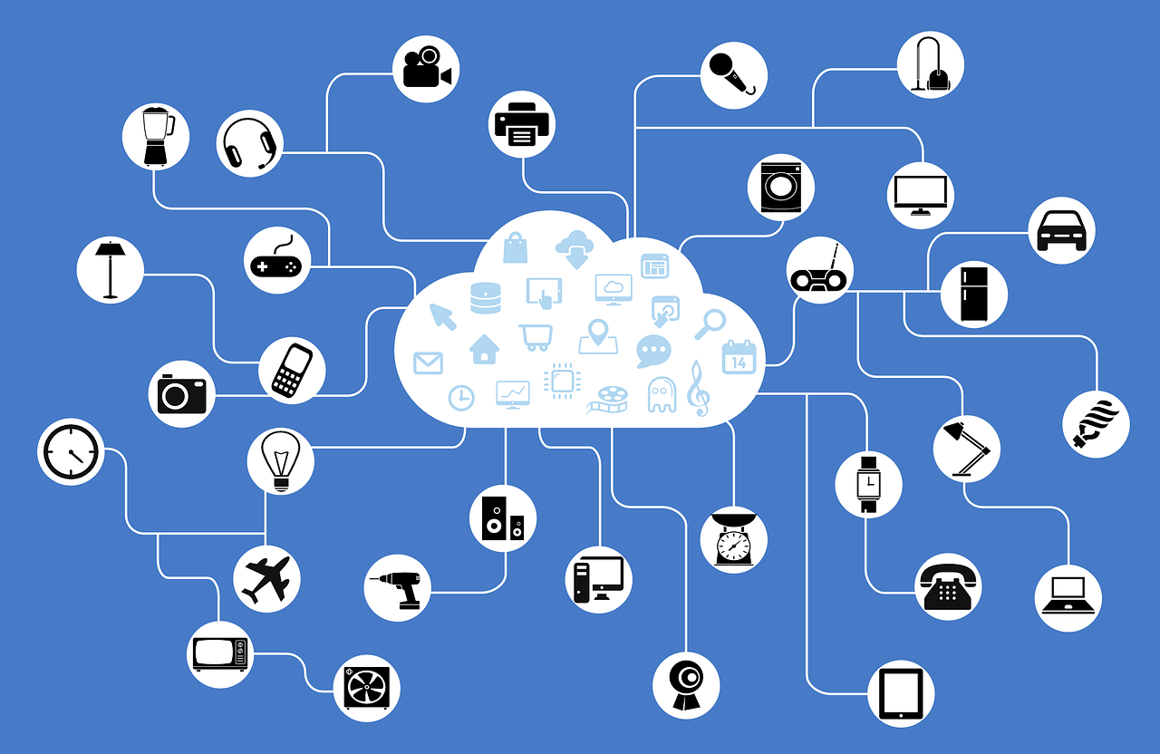
Notes:
SPEAKER: ALEX

Slide 3
Market Analysis - Existing Systems
Nest
Alexa
Home Multimedia Systems
Notes:
SPEAKER: ALEX

Slide 4
Market Survey - Communication Standards
WiFi
Bluetooth
BLE Mesh
ZigBee
Notes:
SPEAKER: ALEX

Slide 5
Problem Statement
Numerous Smart-Home Apps
Single Point of Failure
Competing Proprietary Standards
Security Concerns
Cloud Dependent
Notes:
SPEAKER: DANIEL

Slide 6
Project Statement
Ecosystem of Smart Devices
Open Source Standard
Unified Control Interface
Fault Tolerant by Design
Notes:
SPEAKER: RYAN

Slide 7
Conceptual Sketch
Notes:
SPEAKER: RYAN
Quarks: Smart Devices/Systems
Particles:
Protron/Neutron: System Resource Wrapper
Electron: 3rd Party Applications and Extensions
Atoms: Manage A Collection of Particles
Bonds: Communication between Atoms

Slide 8
Functional Requirements - Bonding
Bonding Layer
  Route Messages
  Facilitate Service Discovery
  End-to-End Encryption
  Identity Verification
Messages
  Action to Perform
  Destination Identifier
Notes:
SPEAKER: DANIEL
Destination Filter:
Device :: Particle Type :: Instance
Explicit
Broadcasts
Implicit

Slide 9
Functional Requirements - Atoms
Manage Particle Lifecycle
Synchronize Particle State
Enforce Permissions
Notes:
SPEAKER: NATHAN
Permissions:
can particle perform this action
are they allowed to communicate with this destination
do they have broadcast privleges

Slide 10
Functional Requirements - Particles
Common Package Format
Action/Permission Manifest
Isolation
Shared State
Multi-Instance Support
Notes:
SPEAKER: NATHAN
Isolation – no direct access to system resources; separate execution environment
- neutrons – system resources
Shared State – Between all nodes
Multi-Instance Support – Redundant Particles

Slide 11
Non-functional Requirements
Stable API with Documentation
No Single Point of Failure
Low Latency High Bandwidth
Minimal Downtime
Notes:
SPEAKER: ALEX

Slide 12
Design Considerations - Fault Tolerance
Faulty Nodes
Synchronization
  Network Failure
Consensus
Notes:
SPEAKER: NATHAN
Network Failure: Countinues happily, merges changes when reconnected

Slide 13
Potential Risks and Mitigation
Complex System
Distributed Network
Multi-language Project
Modularization
Continuous Integration
Documentation
Milestones
Notes:
SPEAKER: RYAN
Multi-language:
Linux
Javascript – User Interface Particle
Rust – Everything Else

Slide 14
Resources/Cost Estimate
Open Source Technologies
Fall 2016: 425 Man Hours
Spring 2016: 600 Man Hours
Low Cost Compute Devices
Notes:
SPEAKER: ALEX

Slide 15
Detailed Design - Bonding Layer
Notes:
SPEAKER: DANIEL

Slide 16
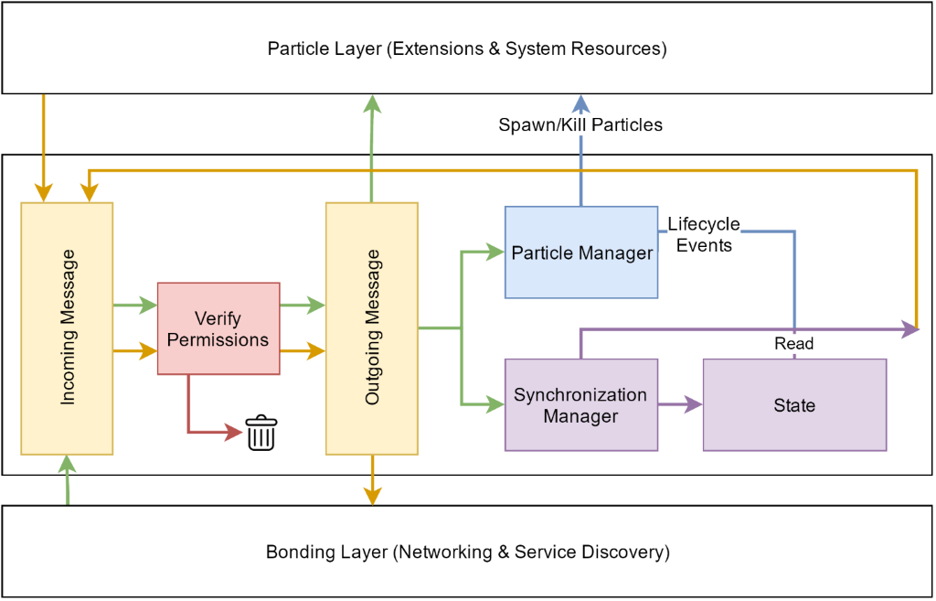
Detailed Design - Atomic Layer
Notes:
SPEAKER: RYAN

Slide 17
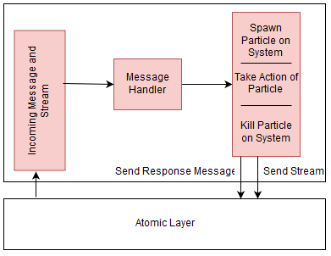
Detailed Design - Particle Layer
Notes:
SPEAKER: NATHAN

Slide 18
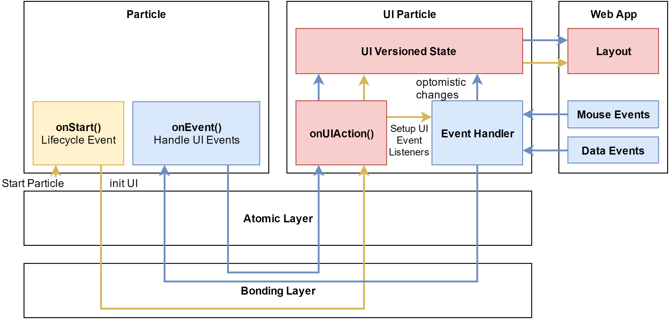
Use Case – User Interface
Notes:
SPEAKER: RYAN
Yellow: Electrons register Panes and Message Listeners (Event Bindings) with the UI Neutron.
Red: UI Neutron receives messages and updates the Web Apps state and user interface. Any changes to the state also fire the synchronization Change Listener
Green: When the UI Neutrons state changes (red), the data is synchronized between all of the nodes. This will cause UI Neutrons on other nodes to receive similar UI Updates (green dotted line to red)
Blue: Web App UI action occurs (onClick, onDataChange) and optimistically changes the user interface. The UI Neutron sends a message to the listeners (Event bindings) registered from the Electrons (yellow). The Electron receiving this event processes the changes and then commits them to the UI Neutron’s UI API (red)

Slide 19
Project Schedule - Fall 2016
Milestone #1 - Architecture
System Diagrams – Team
Requirements - Team
Milestone #2 – Design & Prototyping
API development - Team
Hard coded UI – Ryan
Resource Procurement – Nathan
Website - Alex
Milestone #3 – Limited Feature Set
Object/class based particles - Nathan
CLI Bonding Layer – network routing - Daniel
Compile time extensibility (not runtime) - Daniel
Notes:
SPEAKER: DANIEL

Slide 20
Project Schedule – Spring 2017
Milestone #4 - Configuration
Routing Algorithm - Daniel
Service Discovery - Daniel
Markup Based UI Language – Ryan, Alex
UI Synchronization - Alex
Neutron Creation
Milestone #5 – Integration
Particle Package
Atomic Level Integration
Milestone #6 – Fault Tolerance
Security
Synchronized Configuration
Notes:
SPEAKER: DANIEL

Slide 21
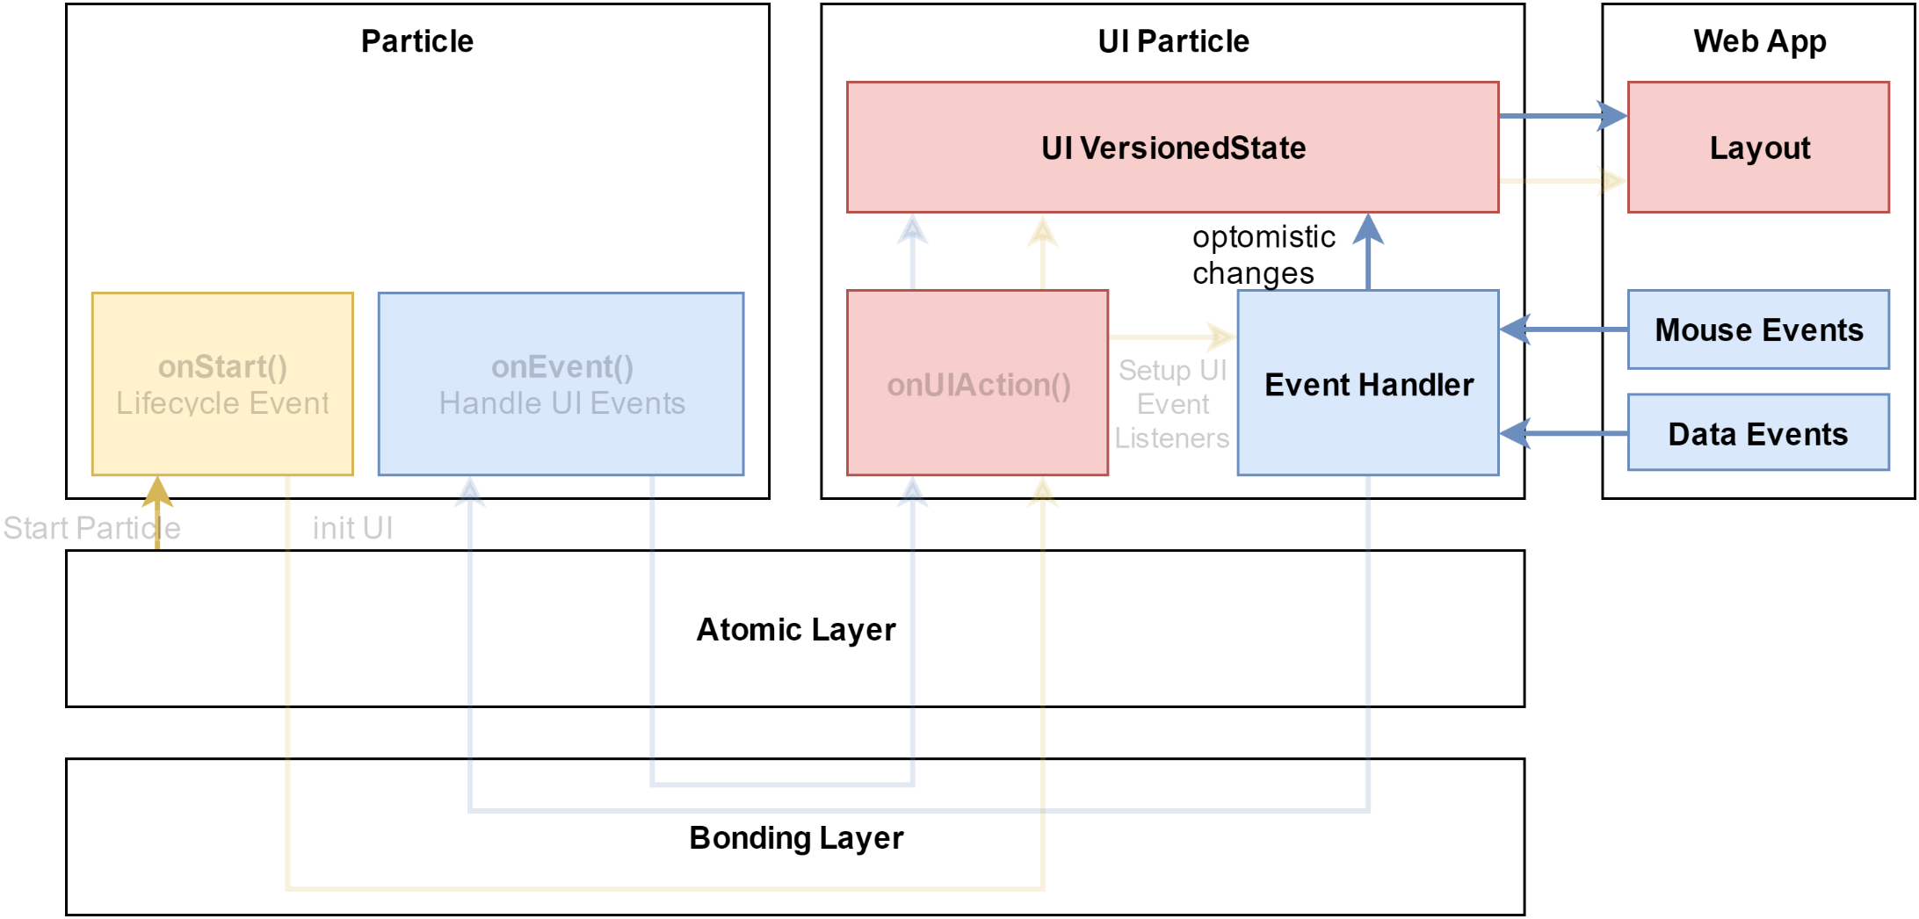
User Interface - Demo
Notes:
SPEAKER: RYAN

Slide 22
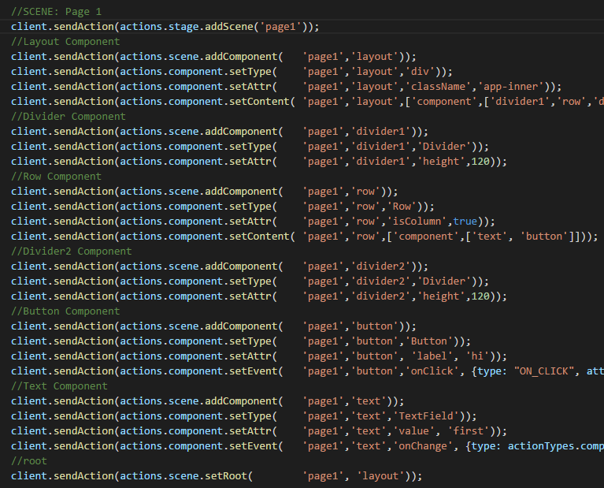
Server Side: onUIAction()
Mock Actions from Another Particle
Commit Action to Versioned State
Broadcast Action to all Web Clients
Notes:
SPEAKER: RYAN

Slide 23
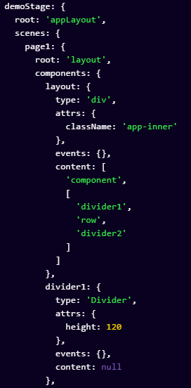
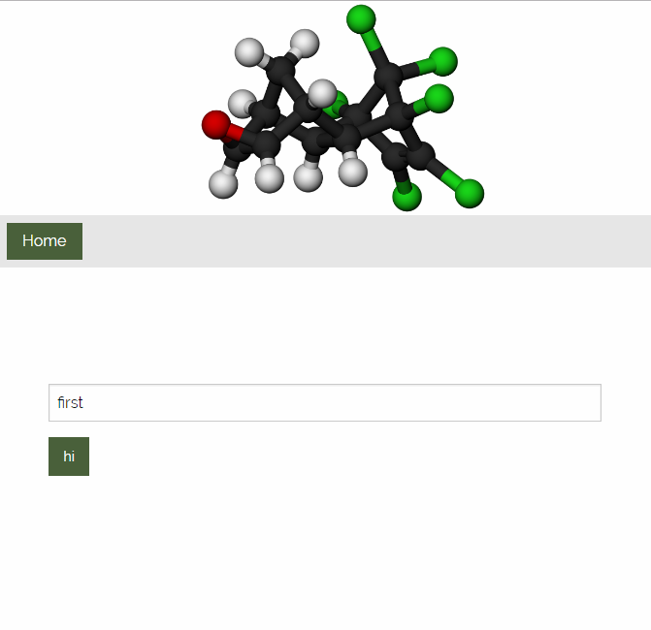
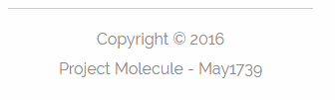
Web Client:
Layout
Receive UI Action
Build Layout Changes
Re-Synchronize if Error
Render Layout
Notes:
SPEAKER: RYAN

Slide 24

Data Event or Mouse Event
Send Event to Server
Process in Event Handler
Optimistically Update All Clients
Render Layout
Notes:
SPEAKER: RYAN

Slide 25
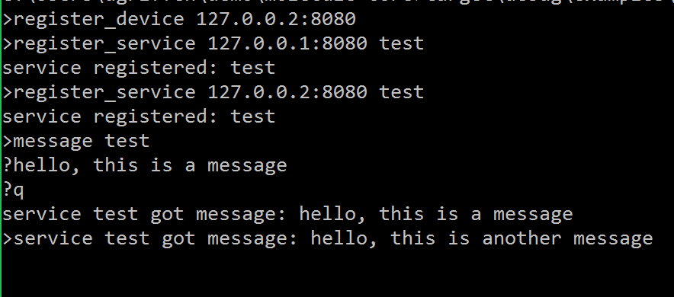
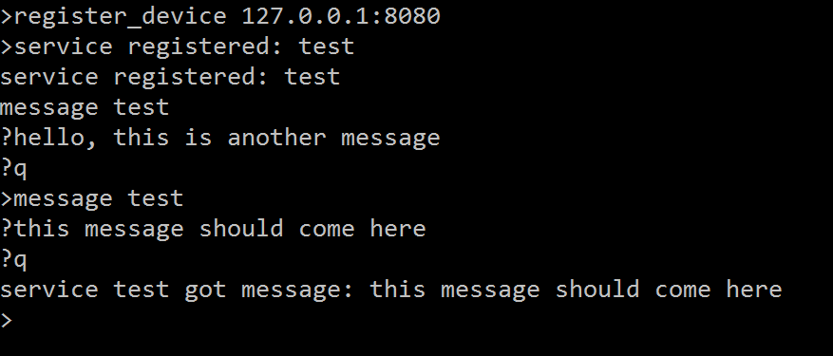
Bonding Layer - Demo

Slide 26
Q/A Slides

Slide 27
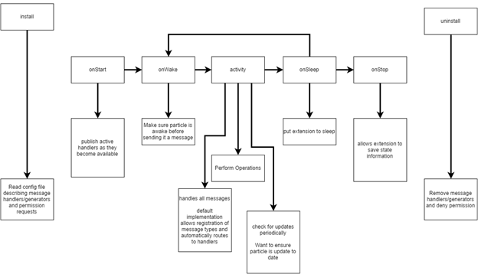
Particle Lifecycle

